Slide 1

NBA EFFICIENCY
Moriah Taylor

Slide 2
THE DATA
Seasons 1996-97 through 2015-16
All data scraped from basketball-reference.com
Player statistics (avg per game)
Player biographies
MVP voting

Slide 3
NBA EFFICIENCY
The formula for NBA Efficiency was invented by Martin Manley and its formulation is as follows:
NBA Efficiency = (Points)+(Rebounds)+(Steals)+(Assists)+(Blocked Shots)
-(Turnovers)-(Missed Shots)
Pros
Simple
Easy to calculate
Cons
Not as precise as possession-based statistics

Slide 4
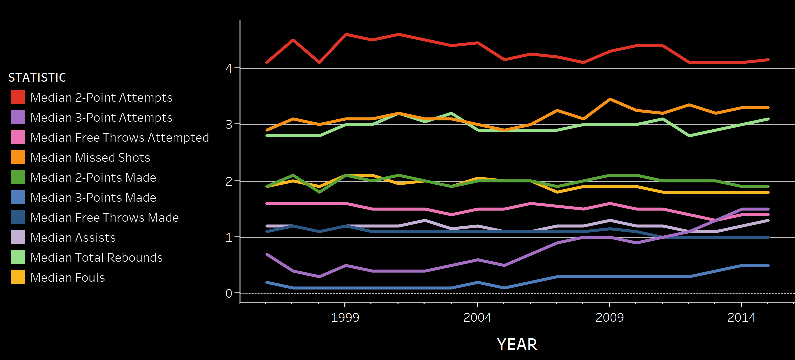

Slide 5
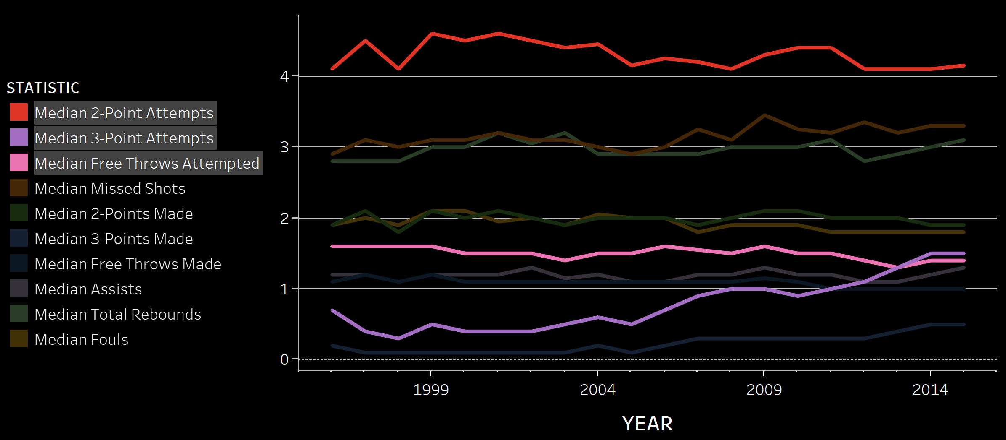

Slide 6
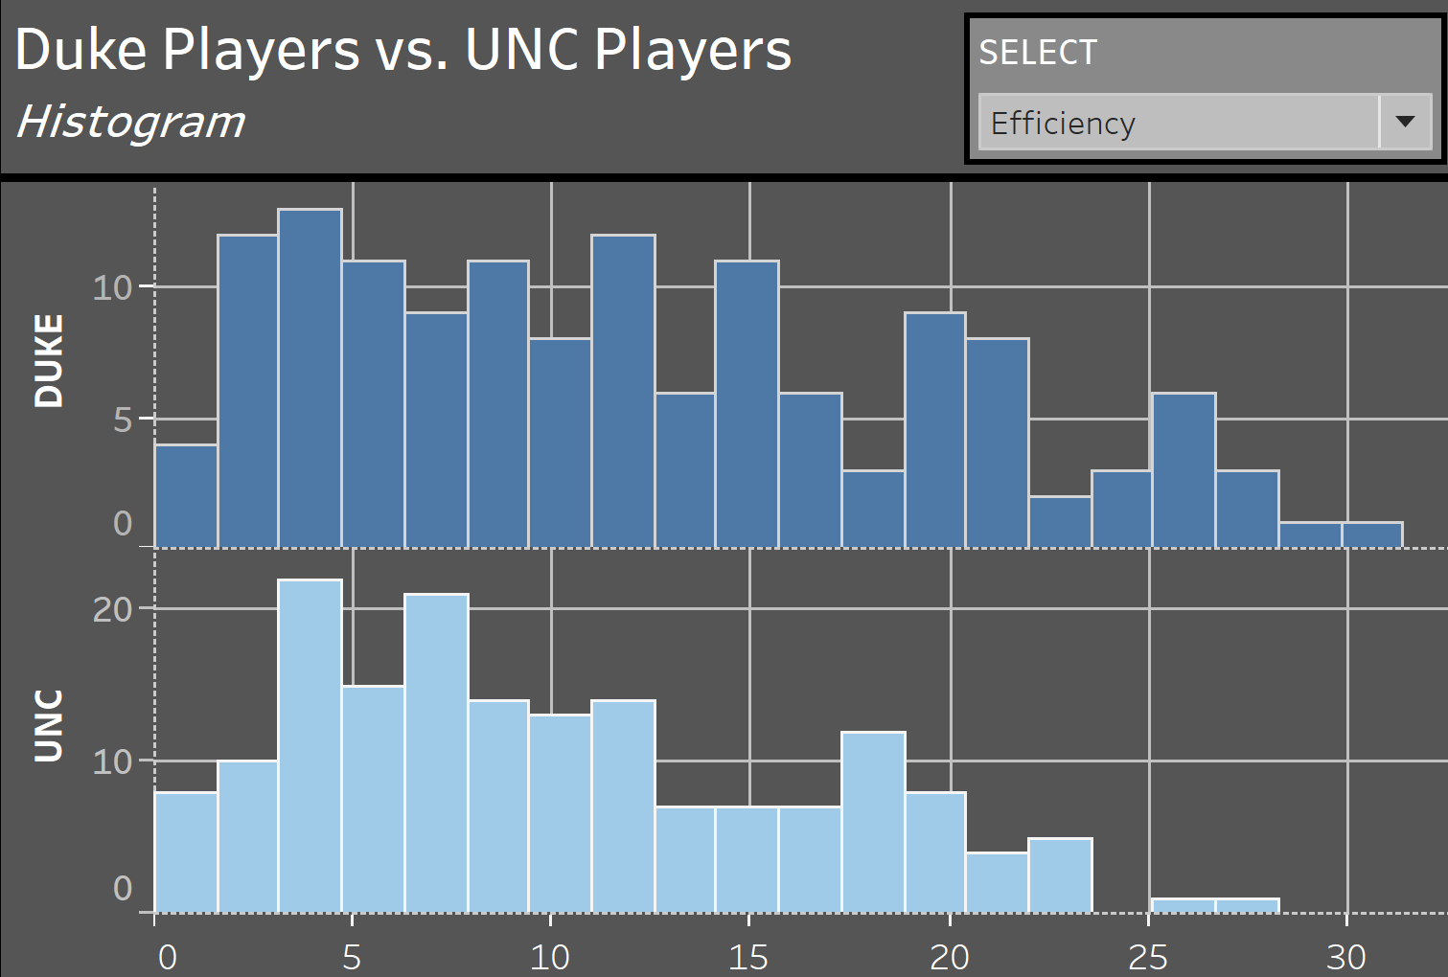

Slide 7
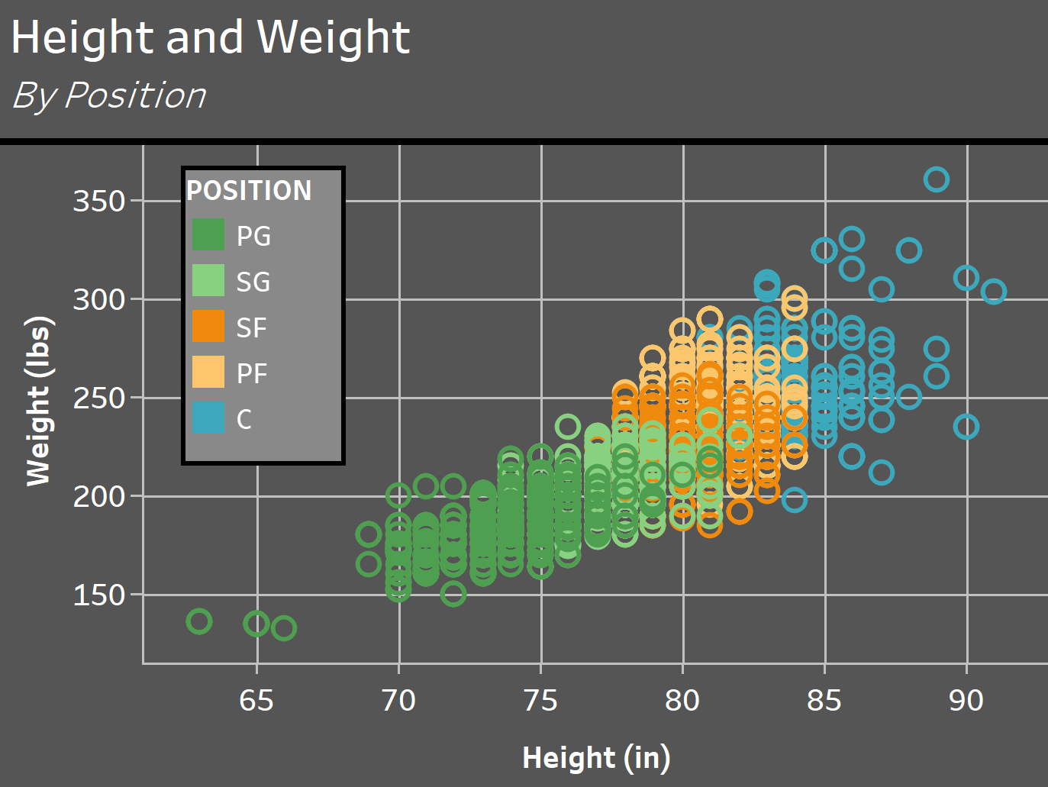

Slide 8
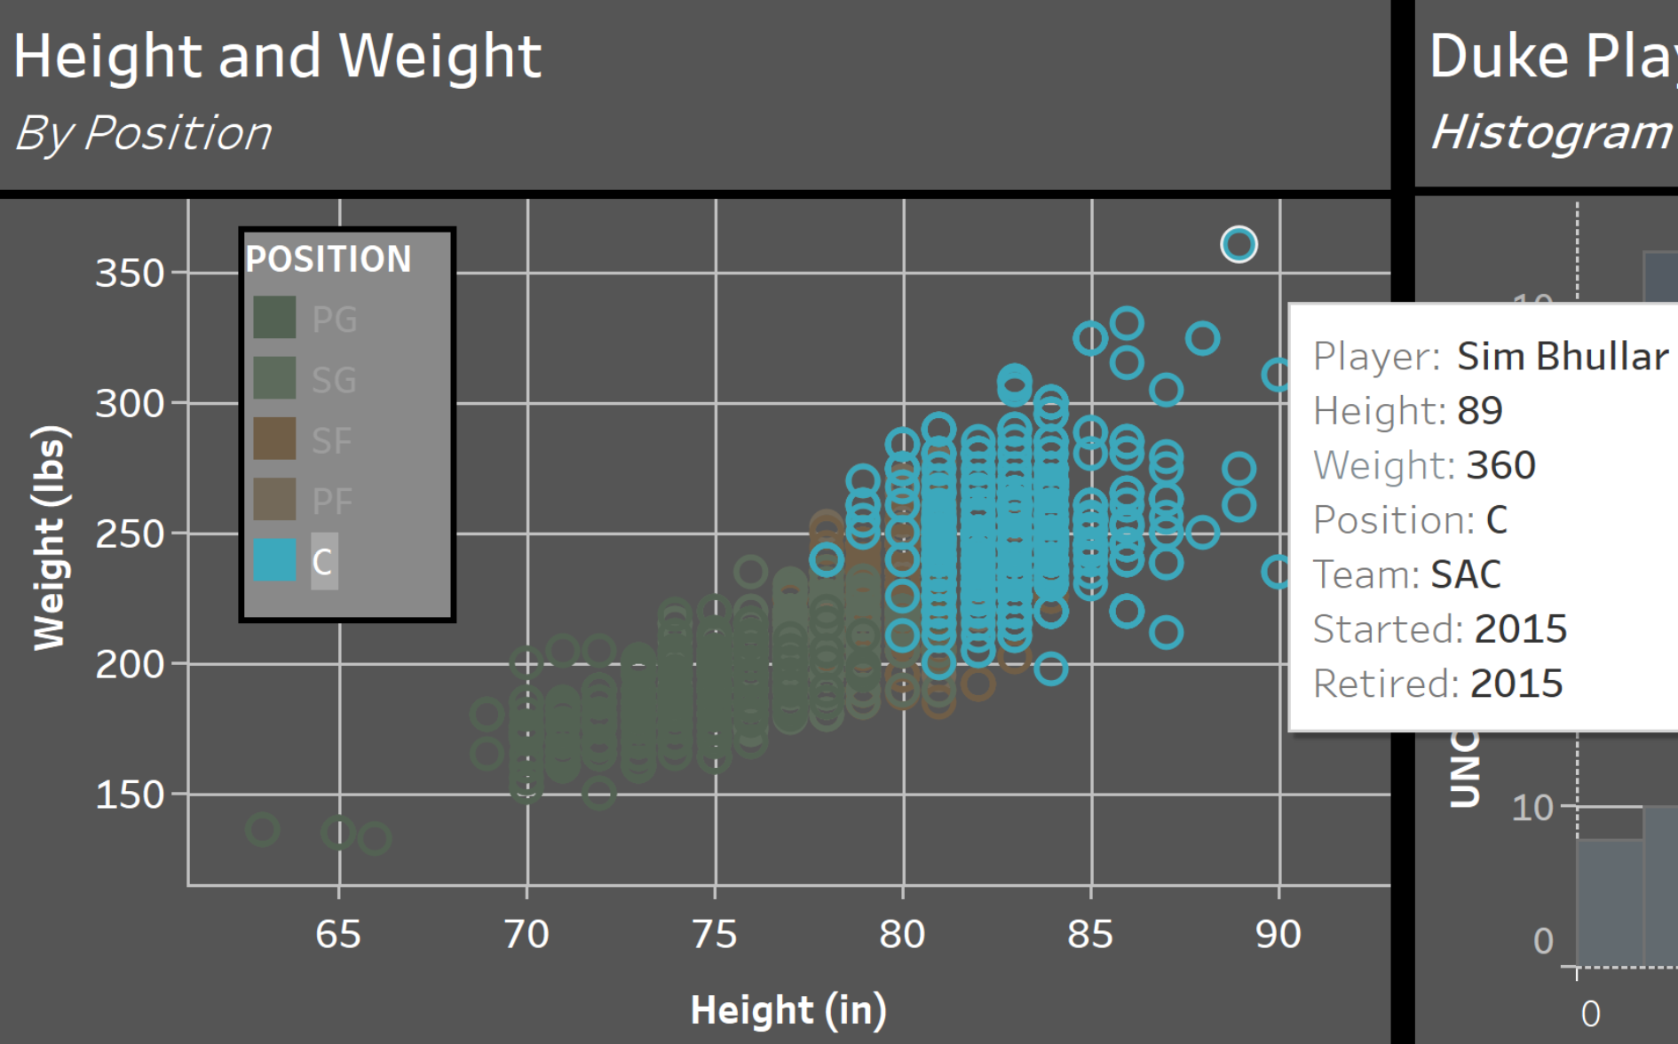

Slide 9
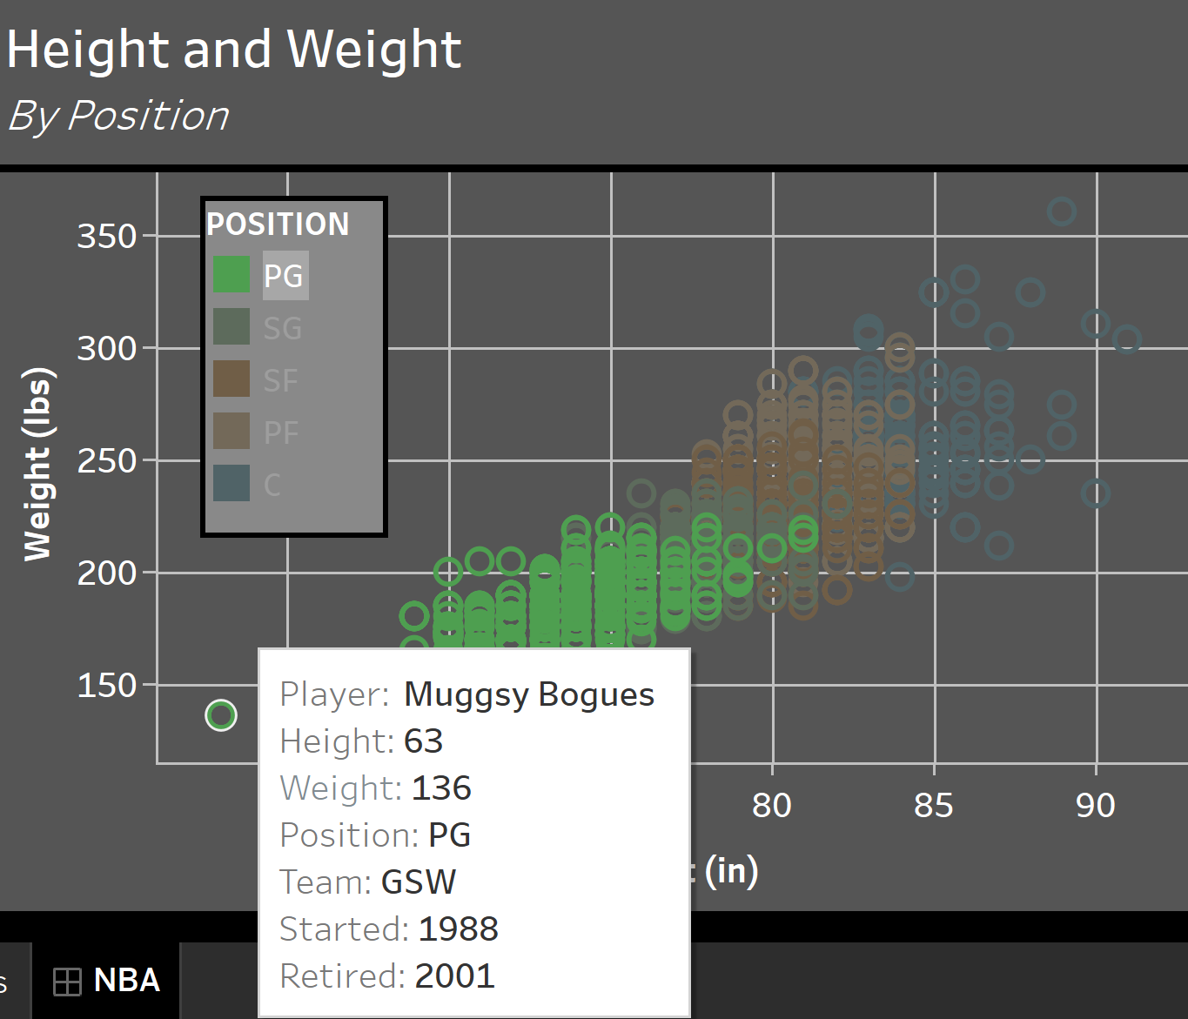

Slide 10
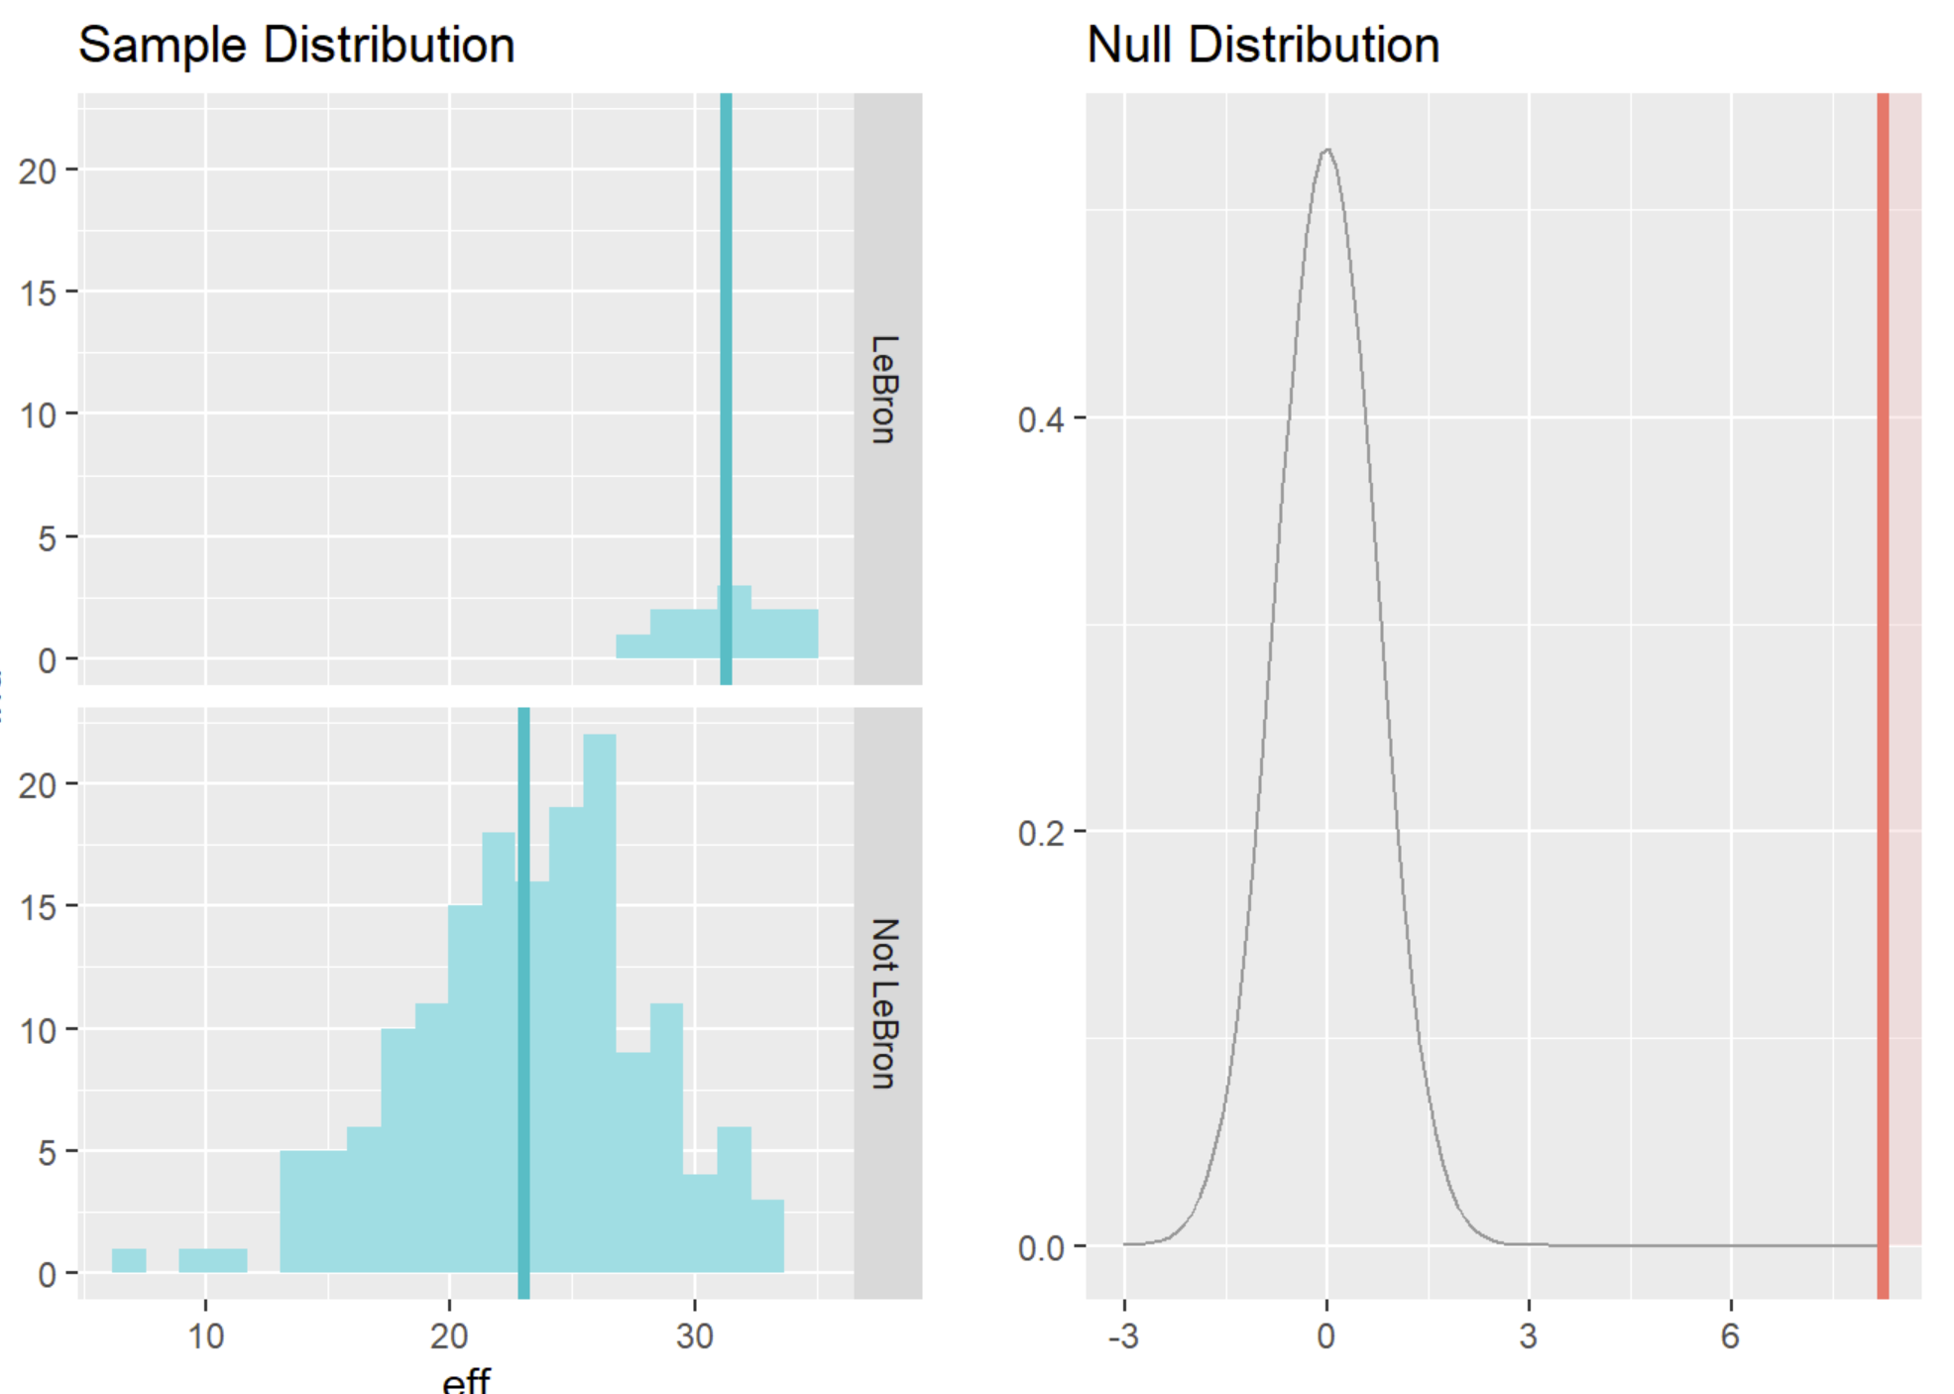
“Is LeBron James the best player in the league?”

Slide 11
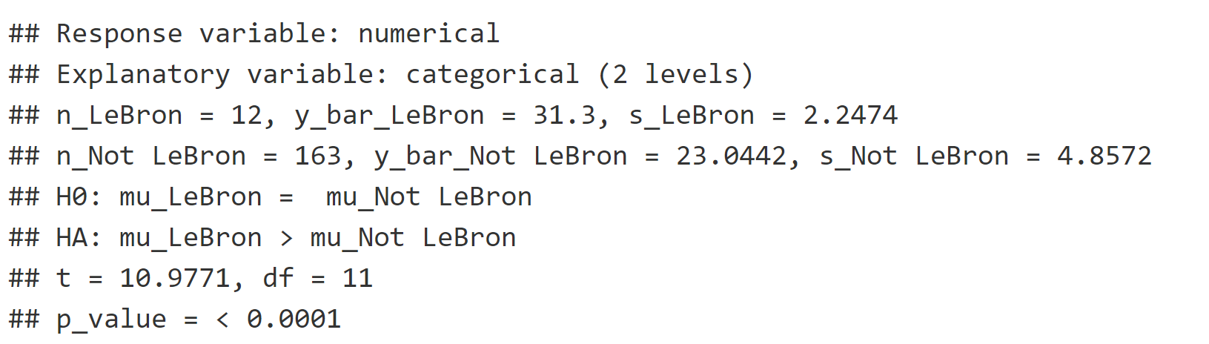
“Is LeBron James the best player in the league?”

Slide 12
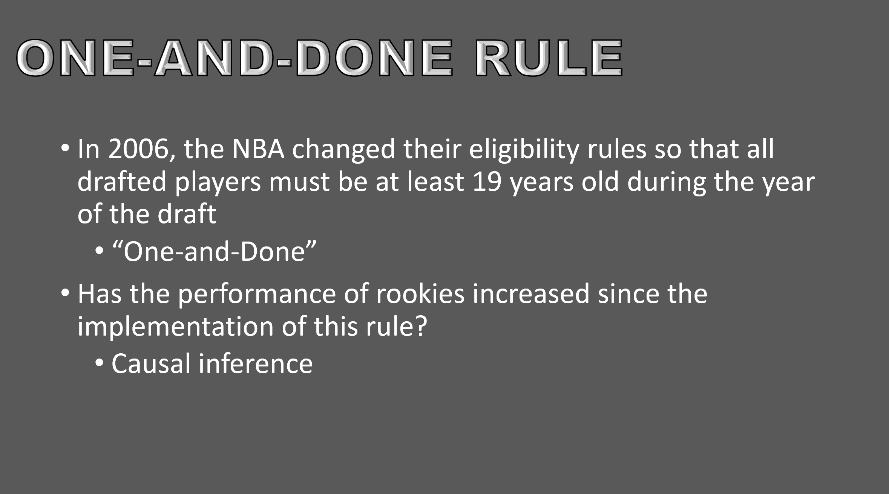

Slide 13
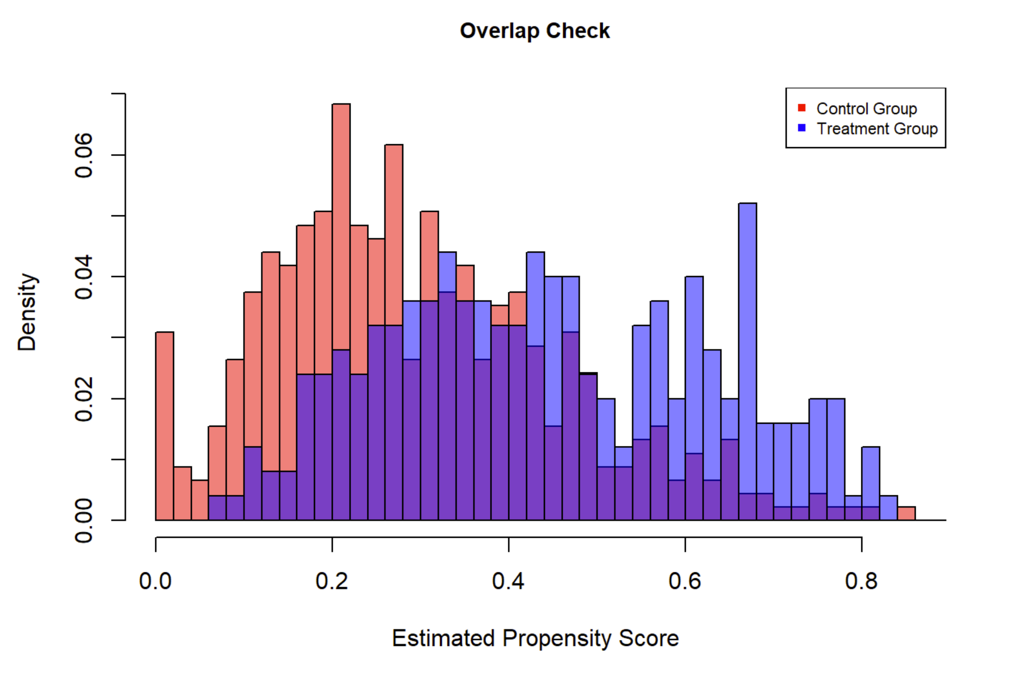

Slide 14
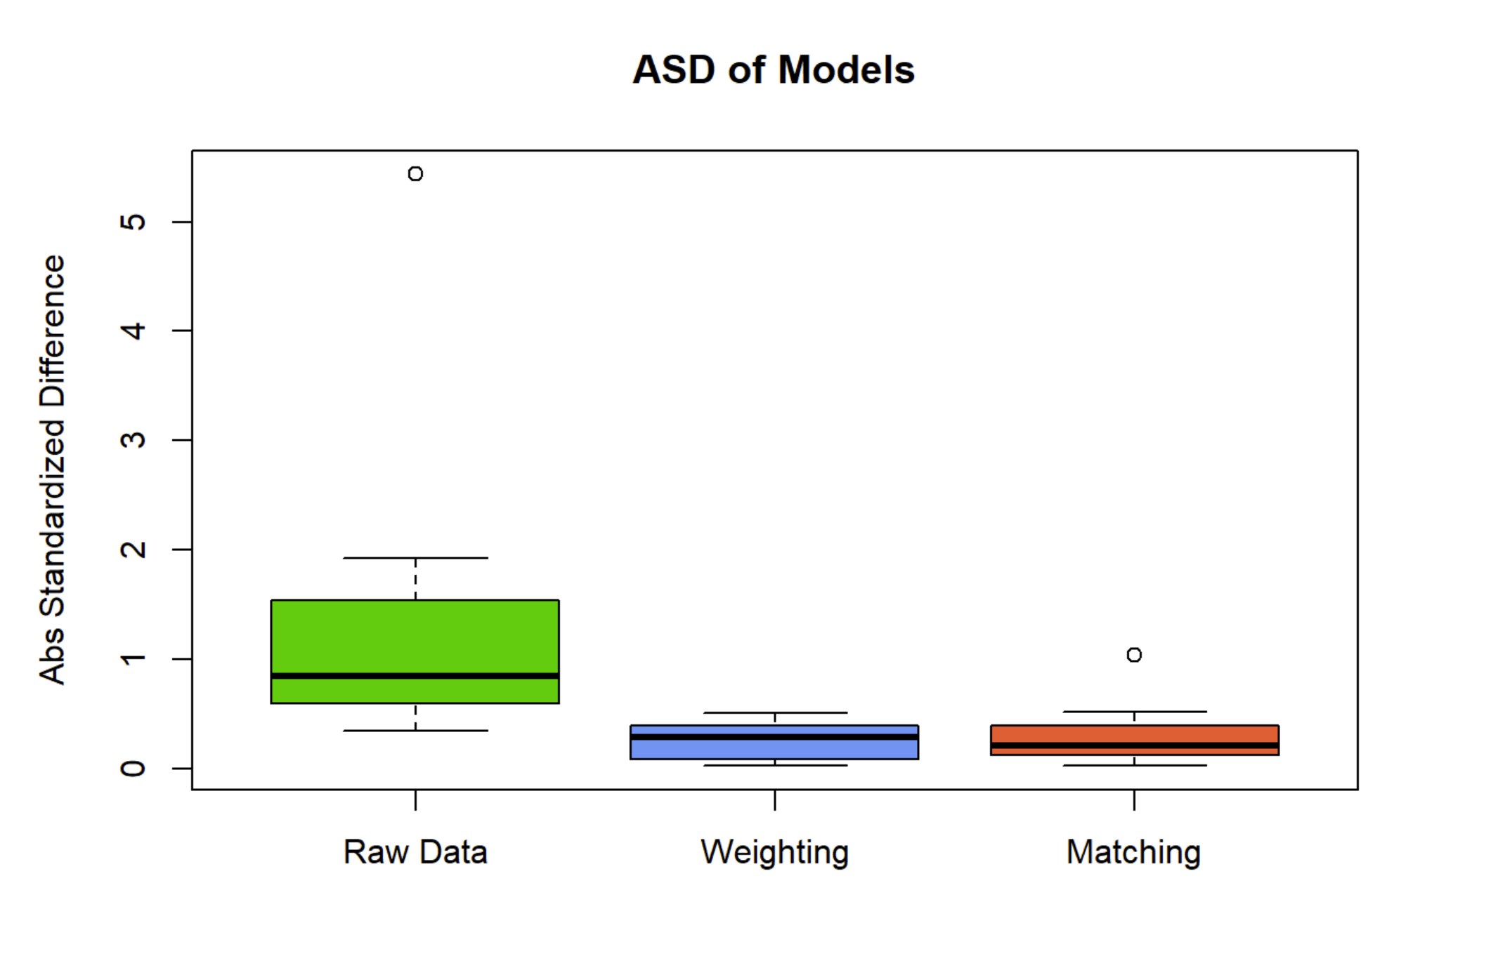

Slide 15
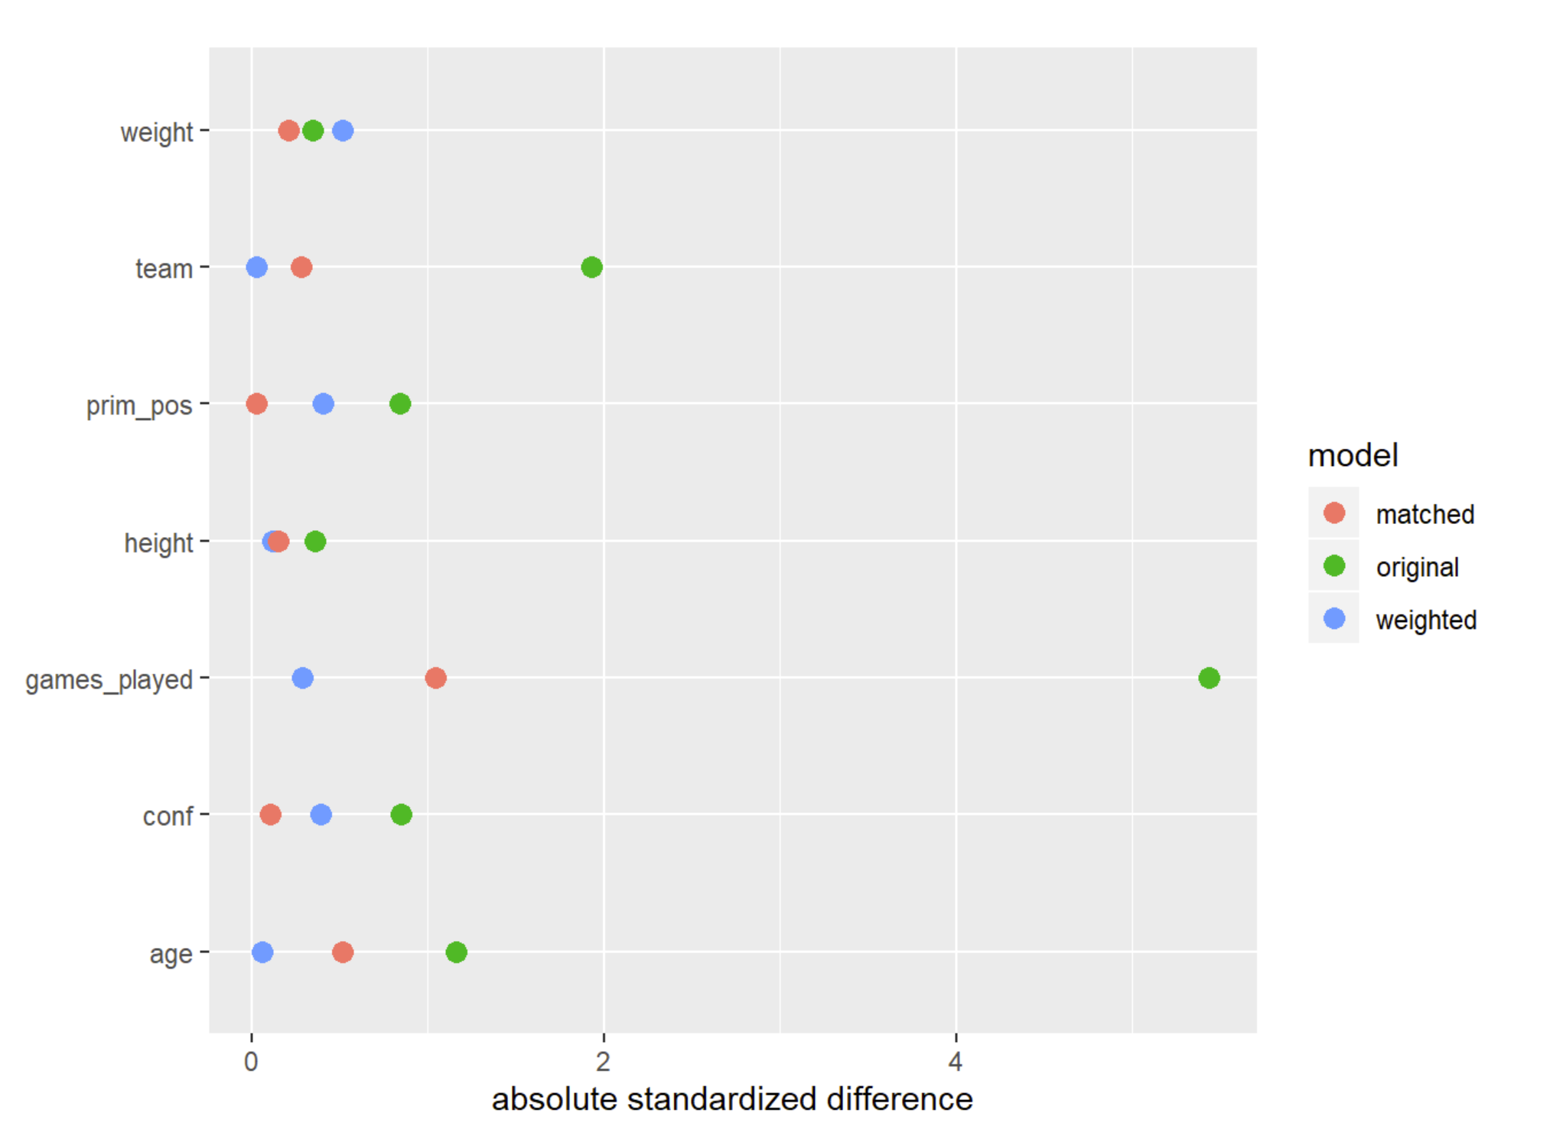

Slide 16
